Slide 1
Predictive Modeling for Food Product Shelf Life
Authors:
Brian Bonertz & Reuben Martor

Slide 2
Why is Shelf Life Important?
Customer Experience
Economic Impact
Waste
Notes:
Customer experience: Ensuring food safety and preventing foodborne illnesses. It also plays a key role in maintaining sensory and nutritional quality of food products meeting customer expectations.
Economic Impact: Brand Protection, Full potential use of the product, Extend sales time, expand sales territory
Waste: If you can maximize product shelf life you, maximize the use of the product and reduce amount of product waste.

Slide 3
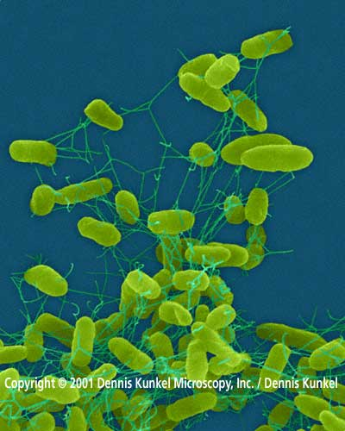
Processing Factors that Influence Shelf Life
TIME
TEMPERATURE
INITIAL MICRO LOAD
Notes:
Processing factors include the overall industrial practices that can influence the ultimate length of shelf life of a product. In this case Pork. From the moment the animal is harvested, meat / muscle begins to degenerate or break down. To slow this process, and maximize use of the product, a manufacturer must follow strong procedures to keep the product clean, cold, and moving. If initial micro load can be reduced to a minimum, there less food spoilage micros that cause breakdown of the product. Reducing and maintaining low temperatures can reduce or inhibit micro activity to flourish and spoil the product. And therefore, the speed from harvest to chilling in a clean an efficient environment can maximize meat product shelf life.

Slide 4
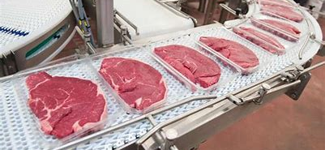
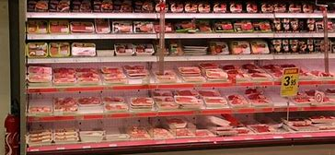
What is Shelf Life
Shelf life is the period between packaging of product and its end use when it remains acceptable to the product user. (Robert J. Delmore, Ph.D., 2020)

Slide 5

Meat Spoilage Indicators
Odor
Color
Texture
Purge
Notes:
Common indicators that meat or meat product has become spoiled are organoleptic features such as Odor, Color, Texture, or Purge. Product may have an off odor, or rotten egg type of odor when the product begins to show off condition. More extreme would be a strong sulfurous or putrid odor. Color may vary from a lighter or grey color to a brown or green color in extreme cases. Surface texture may range from dry or tacky to slimy with a film. And an excess amount of purge in the packaging my indicate further break down of the meat product resulting in tough product or an unfavorable eating experience.

Slide 6
Study Objective
Determine if we can accurately predict shelf life by evaluating key features of historical shelf-life data
Key Features:
Sensory analysis (Color, Odor, Surface Texture, Purge)
Package Integrity
Age
Micro Load (TPC Value)
Notes:
We have set our objective to determine if shelf life can be accurately predicted by evaluating these key features together. We will look at organoleptic sensory analysis along with age, packaging, and micro load to anticipate what age or micro load will target off condition product.

Slide 7
Method
Data Processing / Cleansing
Exploratory Data Analysis
Model Selection
Model Training / Testing
Validation / Conclusion
Notes:
Data Processing – Handle missing values, encode categorical variables, and normalize numerical
Explore data – Identify patters, correlations, key features
Model Selection – Find best fit model for our data type and problem statement
Model Training / Testing – Assess model performance
Validate / Conclusion – Cross validate and conclude results.

Slide 8
What we hope to learn
Key factors affecting shelf life
Predictive model development
Model accuracy and reliability
Valuable insight to improving production strategies
Addressing data bias and ethical strategies

Slide 9
Important Considerations
Variability in processing
Organoleptic or sensory bias
Variability in product type
Notes:
Variability in Processing – The data was collected from 6 different processing facilities. Each facility may have processing or environmental influences that may introduced different processing factors that may affect shelf life (time, temp, load)
Organoleptic sensory bias – Sensory analysis is human perception based. Although trained technicians are established to perform organoleptic analysis and data collection, these results are acquired from different laboratories and technicians. It is possible that perception of odor, color, or texture vary from technician to technician or between labs / regions.
Variability in product type – several different primal types were used in the study including bone in and boneless products. These primals are processed in different manners and different areas. Furthermore some primals may require additional processing that others. It is possible that different primals or primal types have vary in the amount of shelf life.

Slide 10
Data Set
2023 Shelf-Life data collected between 6 pork processing locations
7495 Total Records
17 Original Features
-Record Number
- Date
- Time
- Location
- Type
- Product
- Production Date
- Sample Date
- Age
- TPC Value
- Package Condition
- Purge
- Odor
- Surface
- Product Condition
- Row Number

Slide 11
Data Processing / Cleansing
Anonymity
Location specific items were altered to keep company and location information anonymous
Missing / Duplicate Values
The data set was examined for missing / duplicate values. The column listed as “Purge” contained a high percentage of missing values (64%) and therefore was dropped from the dataset. No duplicate values were observed.
Non-relevant Data
Columns containing record specific identifiers (record number, entry dates / times, row numbers, etc) were eliminated as they were not relevant to the problem statement or objective.
Feature Engineering
Categorical variables such as ‘Product Condition’ were converted to numerical formats using encoding to prep for modeling.
Dummy variables were created for organoleptic results.
Data Split / Scaling
Data was split into train and testing set using 80 / 20 data split
Data was then scaled to align values using standard scaler.

Slide 12
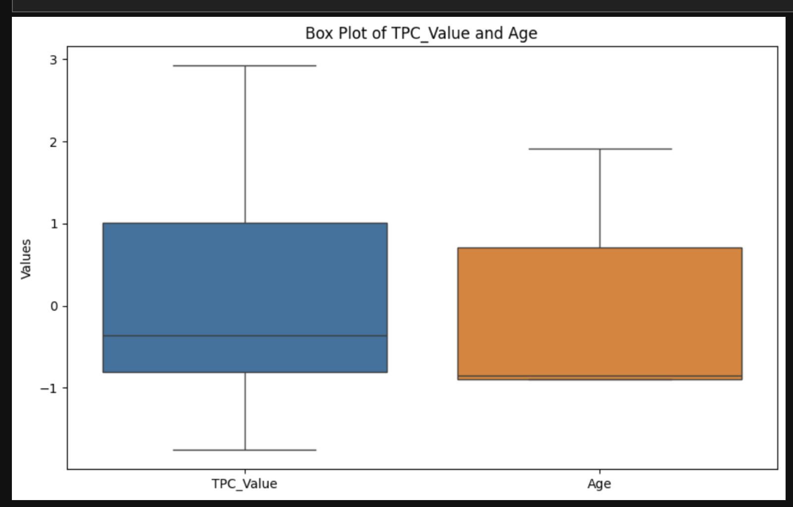
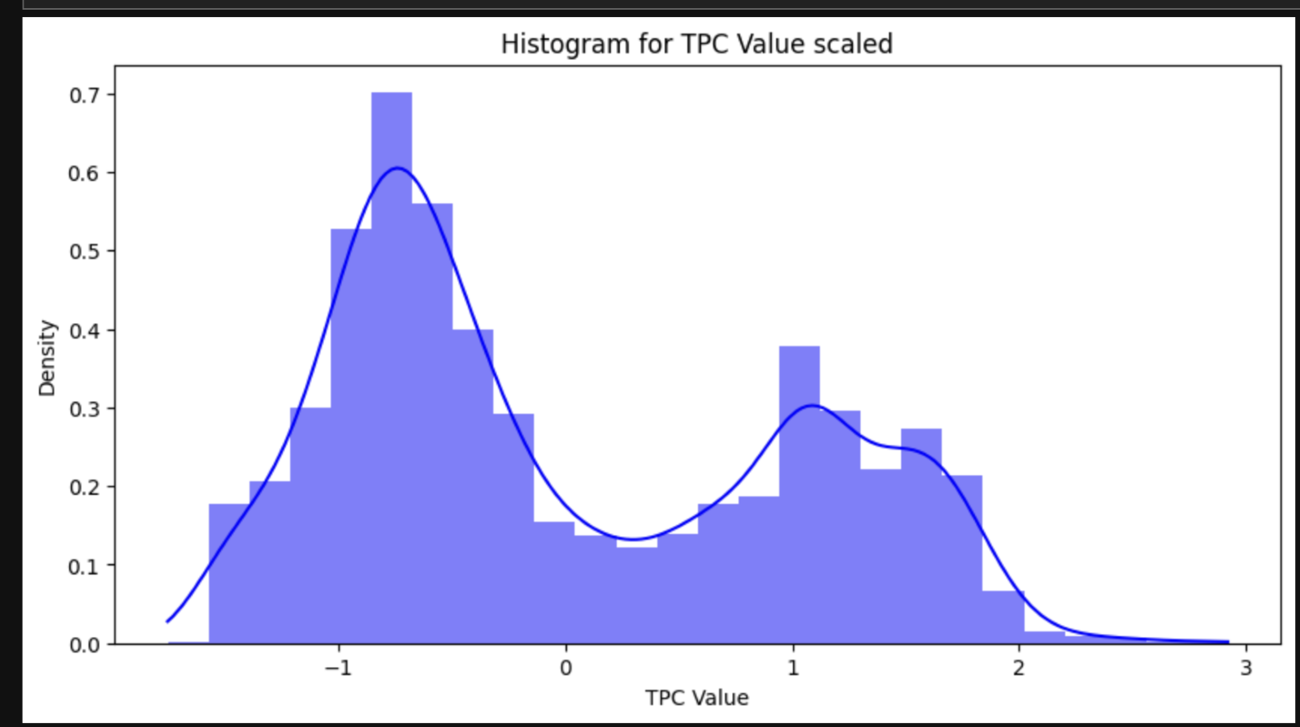
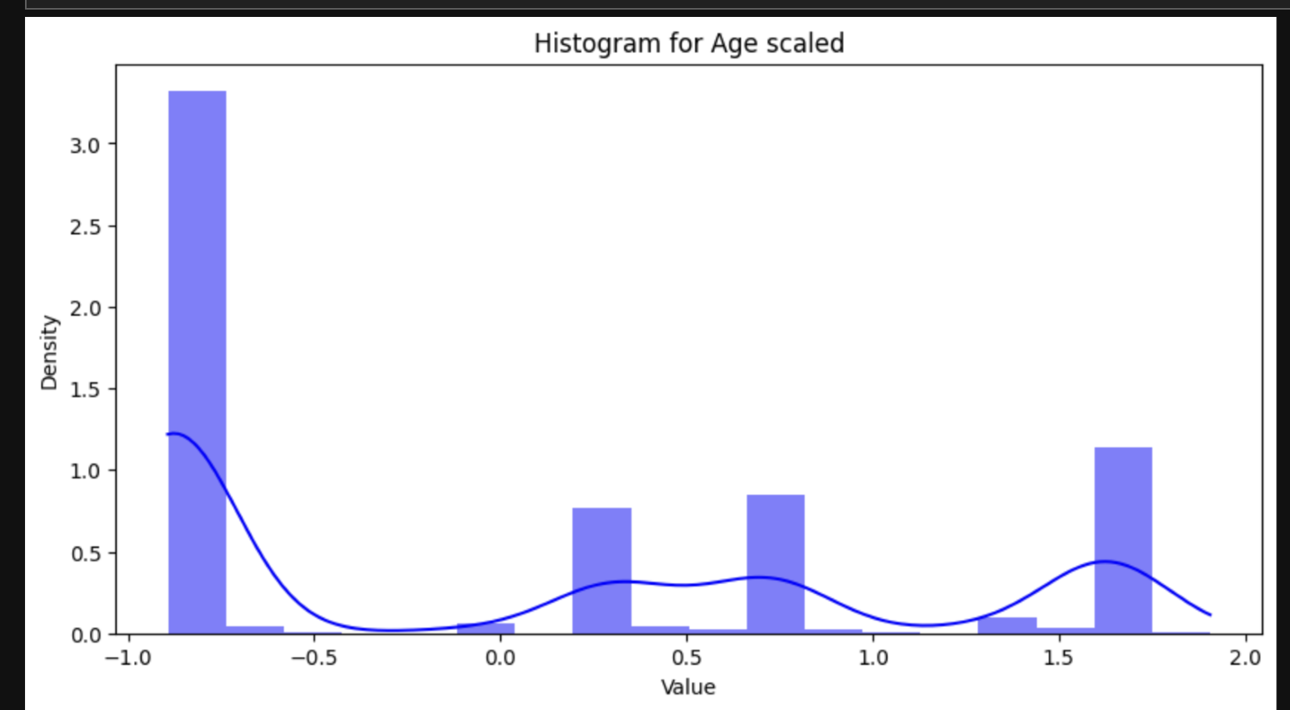
Exploratory Analysis
After scaling the data, comparison was performed between TPC_Value and Age.
Notes:
Results revealed the scaling was successful in producing a more symmetrical distribution, thus improving the standardization for predictive modeling and ensuring the at each variable appropriately contributes during algorithm processing

Slide 13
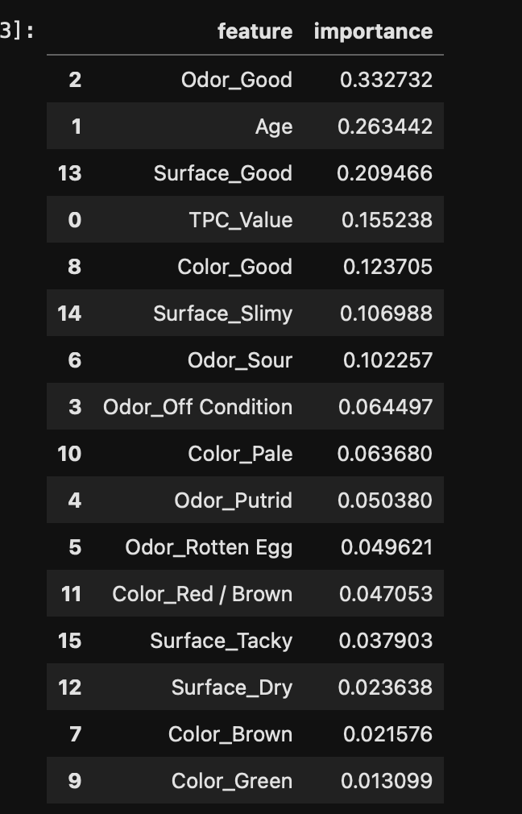
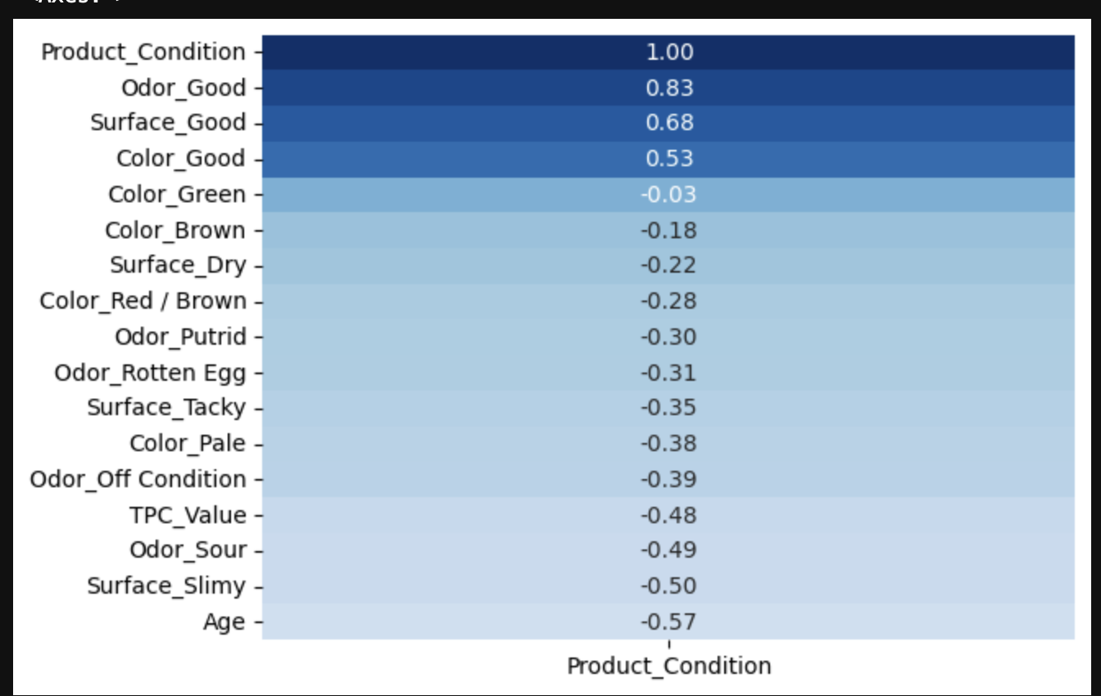
Exploratory Analysis Cont.
Correlation heatmap used to illustrate the correlation coefficients between Product Condition and other features.
To exercise caution and ensure the most appropriate features were selected for modeling, feature engineering was done to determine more important features.
The visualization ranks the features by importance in predicting Product Condition
Notes:
Strong Positive Correlations: Certain features like Odor_Good and Age show stronger positive correlations with Product Condition, suggesting they are good predictors for whether a product will be acceptable.
Negative or Low Correlations: Features such as Surface_Dry and Type show lower correlations, indicating less predictive power.
Most Important Features: Features like Odor_Good and Age top the list, corroborating the insights from the correlation heatmap. Least Important Features: Other features, particularly some odor and surface conditions, contribute less to the model, indicating potential candidates for dimensionality reduction.

Slide 14
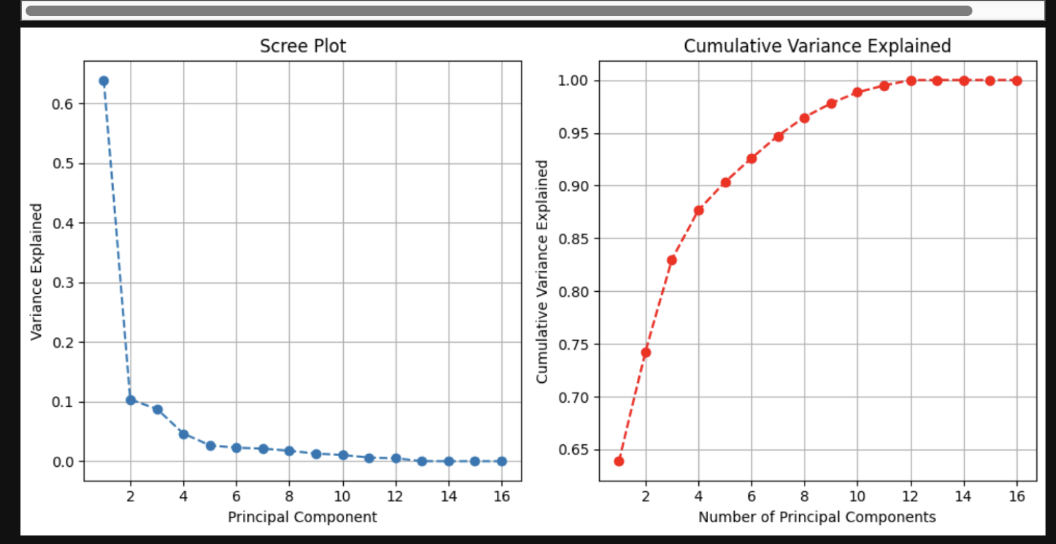
Exploratory Analysis Cont.
PCA Performance of cumulative variance for dimensionality reduction
Notes:
The cumulative variance explained by the principal components shows how much of the total dataset variance is captured as we include more components:
With just the first component, 63.88% of the dataset variance is explained.
Adding the second component increases this to 74.24%.
Including up to the third component reaches 83.01%, and so forth.
Cumulative Proportions:
By the time we include the first 12 components, virtually all (99.99%) of the dataset's variance is accounted for. This comprehensive coverage suggests that we can achieve nearly full information retention with just 12 out of the 16 components, though practically, focusing on the first few may be sufficient for most analytical purposes due to diminishing returns in explained variance with each additional component.

Slide 15
Model Selection
Logistic Regression
Support Vector Machines (SVM)
K-Nearest Neighbors (KNN)
Random Forest.
Notes:
A variety of models were considered.
Each model was chosen based on its ability to handle binary classification tasks effectively.
Cross-Validation and Hyperparameter Tuning: The models were evaluated using cross-validation to ensure that the model performance is stable across different subsets of the dataset. Hyperparameters were tuned using GridSearchCV to find the optimal settings for each model.

Slide 16
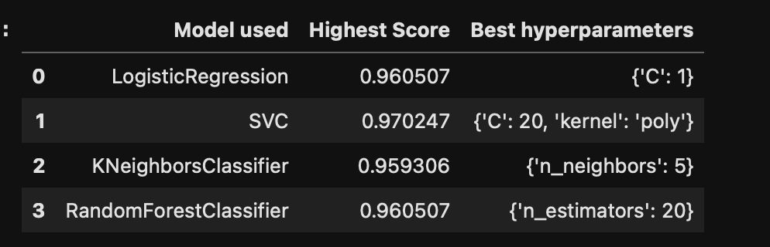
Model Selection
SVC Model
Logistic Regression

Slide 17
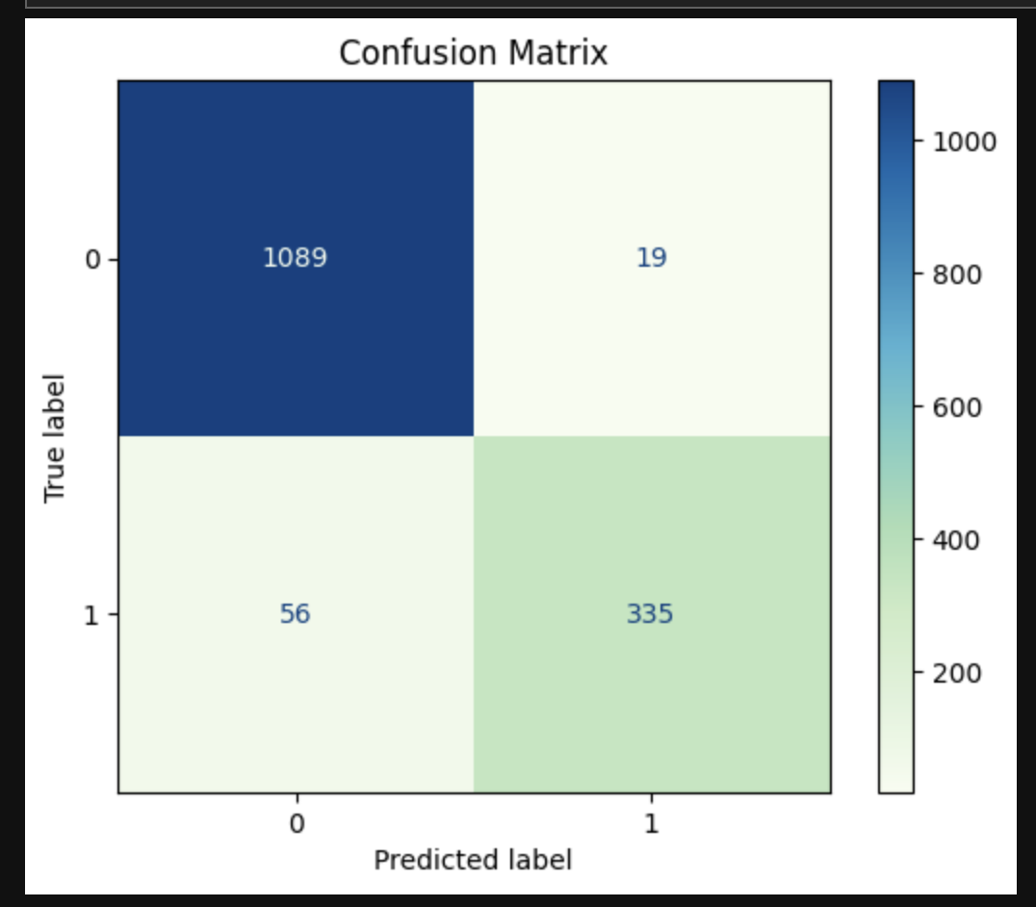
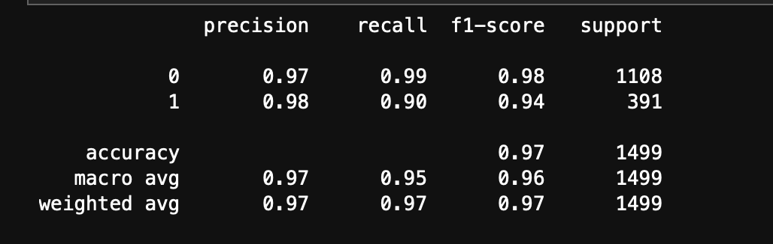
Model Training / Testing SVC Model
The model performs exceptionally well overall, with a high accuracy of 97%.
For class 0 (good/Acceptable product), the model is almost perfect, achieving a recall of 99%, which indicates very few false negatives.
For class 1(bad/unacceptable product), the model performs slightly less well, with a recall of 90%, indicating more false negatives compared to class 0.
The precision for both classes is very high, indicating few false positives.
The high F1-scores for both classes, especially for class 0, suggest a strong balance between precision and recall.
The macro average metrics are slightly lower than the weighted average metrics, reflecting the imbalanced nature of the dataset (more instances of class 0 than class 1).

Slide 18
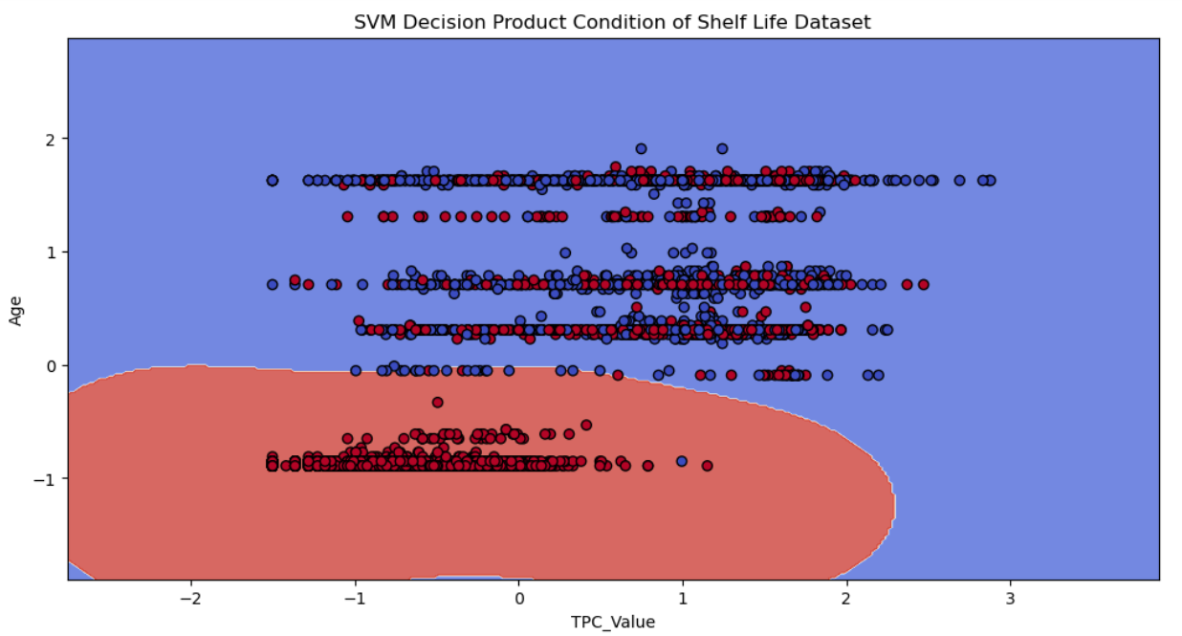
Model Training / Testing SVC Model
The decision boundary is a scatter plot of TPC_Values and Age by the target Product Condition
Red Grouping indicates Good Product Condition
Blue Grouping indicate Bad Product Condition

Slide 19
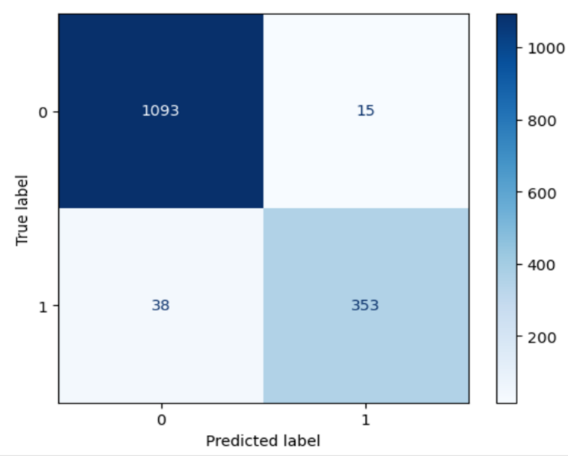
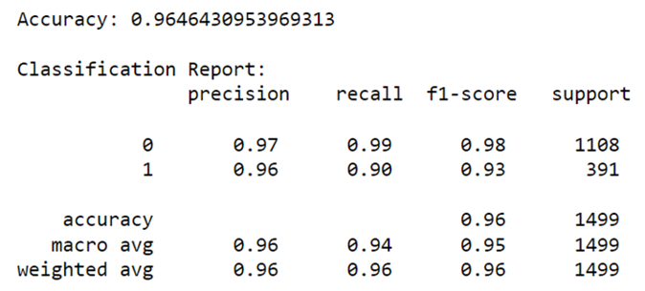
Model Testing / Training Cont. Logistic Regression
- This model also performs exceptionally well overall, with a high accuracy of 96%.
- The high accuracy and F1- score indicate that the model is effective at balancing the rate of true positives and the rates of false positives, making it reliable for predictions on unseen data.

Slide 20
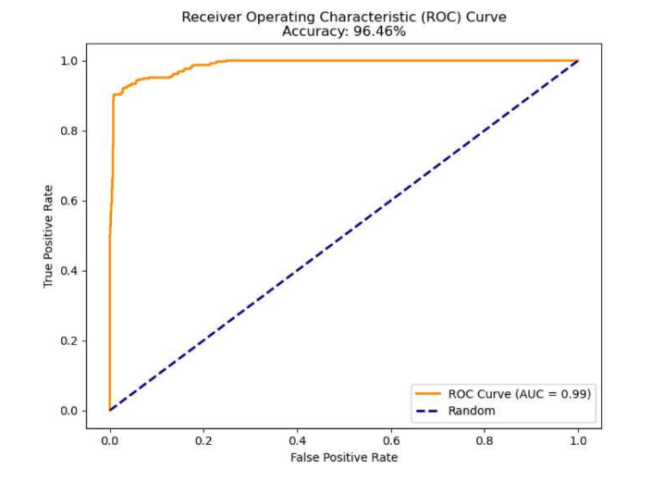
Model Training / Testing Cont. Logistic Regression
The ROC Curve displays the percentage of true positives predicted by the model as the prediction probability is cutoff is lowered from 1 to 0.
The higher the AUC (Area under the curve), the more accurate the model.

Slide 21
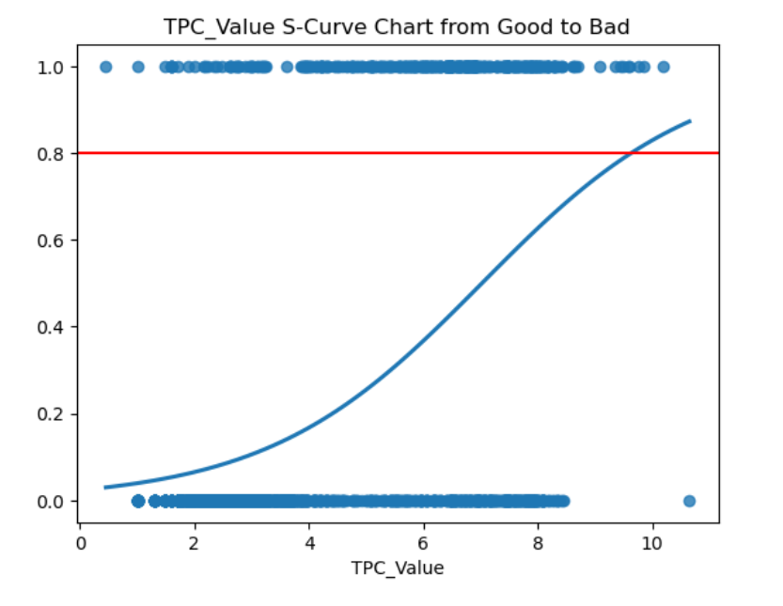
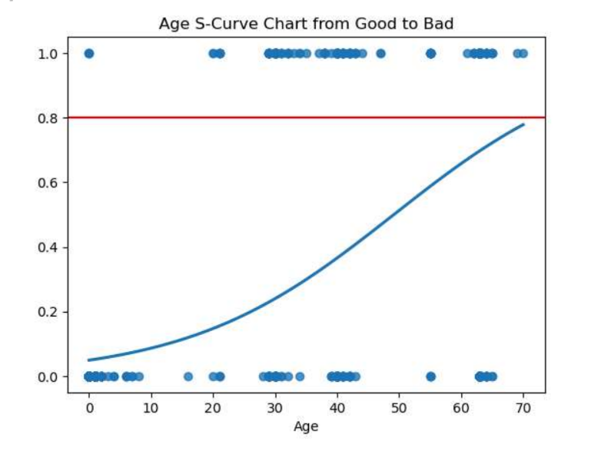
Model Validation
TPC_Value of product condition from good to bad at an 80% confidence level is approximately 9 log
Age at which product condition goes from good to bad with an 80% confidence level is approximately 70 days
Notes:
With use of the logistic regression model with the original dataset, we can see the model does a fine job of predicting the TPC_Value and Age of the product at which the product goes from good to bad with an 80% confidence level.

Slide 22
Interpretation of Results
High Accuracy:
Both the logistic regression and SVC Models were able to predict with high accuracy. Each model achieves above 95% accuracy indicating effective classification of data correctly most of the time
Good Precision and Recall:
Both models present high precision and high recall scores. High precision relates to the low false positive rate, and high recall relates to the low false negative rate.
Balance:
Both metrics are above 95% for each of the models used, showing that the models are well-balanced in identifying both positive and negative classes.

Slide 23
Conclusion / Recommendations
Conclusion: The analysis indicates that certain features significantly influence the outcome and that both the SVM model and Logistic Regression model can effectively predict the target variable using these features. TPC values did also influence the outcome of the model.
Recommendations: It is recommended to further explore the dataset with additional feature engineering, perhaps incorporating new data sources or derived variables. Future models could also explore ensemble methods that might leverage the strengths of multiple learning algorithms.

Slide 24
References:
Beef Shelf-Life, 2020
Robert J. Delmore, Ph.D.
Beef Shelf-Life (beefresearch.org)
Predictive Modeling for Food Safety and Quality of Meat Products, 2021
By Lene Meinert M.Sc., Ph.D., Anette Granly Koch M.Sc., Ph.D., Gry Carl Terrell M.Sc.
Predictive Modeling for Food Safety and Quality of Meat Products (food-safety.com)
Microbial Spoilage of Meat and Meat Products, April 18, 2021
By Sanjogta Thapa Magar
Microbial spoilage of meat and meat products - Microbe Notes
Vacuum-Packaged Meat: Storage Life and Spoilage, November 2023
Meat Industry Service
Increasingly, red meat for retail display is being prepared and packaged centrally rather than at retail stores (csiro.au)
McKinsey & Company. "Data Ethics: What It Means and What It Takes." McKinsey & Company, no date,
https://www.mckinsey.com/capabilities/mckinsey-digital/our-insights/data-ethics-what-it-means-and-what-it-takes#/

